Slide 1
DIRECT AND INVERSE VARIATIONS
STD – VIII
SUBJECT- MATHEMATICS

Slide 3
DIRECT VARIATIONS

Slide 4
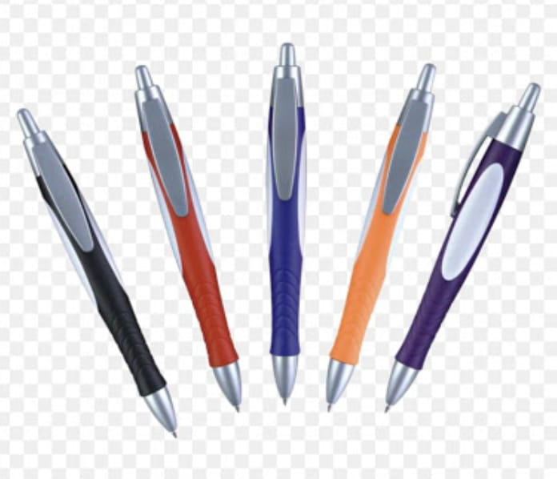
INTRODUCTION
SITUATION - 1
Cost of 5 pens is Rs. 50
Cost of 12 pens is Rs.120
What do you have observed in the relation between number of pens and their cost ?

Slide 5
SITUATION - 2
With a speed of 40km/hr, a distance of 1200km is covered in 30 hrs. When the speed is increased to 60km/hr, a distance of 1200km is covered only in 20 hrs.
What do you have observed in the relation between speed of the car and time taken to cover the given distance?

Slide 6
OBSERVATION
In the 1st situation, an increase in the number of pens
results in an increase in the cost.
In the 2nd situation, an increase in the speed causes in
the decrease in the time (distance remaining same)
From the above observations, it is clear that:
If the values of two quantities are related in such a way that a change in one results in a corresponding change in the other, the two quantities are said to be in variation.

Slide 7
TYPES OF VARIATION
DIRECT VARIATION
INVERSE VARIATION

Slide 8
DIRECT VARIATIONS
Let us consider that the cost of 3kg sugar is Rs. 105.
Then what will be the cost of 5kg sugar ?
To solve the above problem , what should I find first?
So, find the cost of 1kg sugar which will be Rs. 105 ÷ 3 = Rs. 35
Then the cost of 5kg sugar= Rs. 35× 5= Rs. 175
Let’s plot a table between weight of sugar and it’s cost.
Weight of sugar ( in Kg) (X) | 3 | 5
Cost (in Rs.) (Y) | 105 | 175
Can you find out the relationship between
weight of sugar and the cost ?

Slide 9
DEFINITION OF DIRECT VARIATIONS
If two quantities are related in such a way that an increase in one quantity results a corresponding
increase in the other and vice-versa, then such a variation is called direct variation.

Slide 10
In other words, $\frac{x}{y}$ does not change; it remains same.
So, $\frac{x}{y}$ = k (constant)
⇒ ……(i)
From eq.(i), x and y increase or decrease together.
x = ky

Slide 11
Let’s Watch this……

Slide 12
LET’S SOLVE SOME PROBLEMS ...
Find p and q in the following table, if x and y vary directly.
It is given that, x and y vary directly.
So, can you correlate the ratio of x and y in the above table?
Yes, ratio between x and y will be constant as they are in direct variation.
$\frac{x}{y}$ = k ⇒ $\frac{2}{3}$ = $\frac{8}{p}$ = $\frac{q }{39}$
Taking $\frac{2}{3}$ = $\frac{8}{p}$$\frac{ 2}{3}$ = $\frac{q}{39}$
p = $\frac{8 × 3}{2}$ q = $\frac{2 × 39}{3}$
p = 12 q = 26
x | 2 | 8 | q
y | 3 | p | 39

Slide 13
2. A motor boat covers 20km in 4 hours . What distance will it cover in 7 hours (speed remaining same)?
Solution: Let distance covered by the boat in 7 hrs = x km
Prepare a table between the distance covered by the boat and time taken
Can you identify the type of variation is used between distance and time?
As an increase in time, there is corresponding increase in the distance travel, so it is a case of direct variation.
∴ $\frac{20}{4}$ = $\frac{x}{7}$
∴ x = $\frac{20 × 7}{4}$
∴ x = 35
∴In 7 hrs, the boat will cover 35km.
Distance(in km) | 20 | x
Time (in hour) | 4 | 7

Slide 14
YOU MUST TRY ...
If x and y varies directly as each other and x = 2 when y = 40. Find y when x = 16.
Manoj types 540 words during half an hour, how many words would he type in 6 minutes?
Observe the following table and find if x and y are in direct variation.
4. Complete the following tables given that x varies directly as y.
x | 6 | 10 | 14 | 18 | 22 | 26 | 30
y | 4 | 8 | 12 | 16 | 20 | 24 | 28
x | 2.5 | …… | …… | 15
y | 5 | 8 | 12 | ……

Slide 15
INVERSE VARIATIONS

Slide 16
INVERSE VARIATIONS
Let us consider the following table showing the speed of
the car as ‘x’and time taken to cover the same distance
as ‘y’.
Can you establish the relationship between speed of the car and time taken in the above table?
From the above table, it is clear that as the speed of the car increases, time taken to cover the same distance decrease and vice-versa.
Speed in km/hr (x) | 30 | 40 | 60 | 90
Time in hrs (y) | 12 | 09 | 06 | 04

Slide 17
DEFINITION OF INVERSE VARIATIONS
If two quantities are related in such a way that an increase in one causes corresponding decrease in the other and vice-versa, then such a variation is called an inverse variation.
Let’s find out the product of speed of the car and time taken to cover the same distance.
30 x 12 = 360, 40 x 9 = 360, 60 x 6 = 360, 90 x 4 = 360

Slide 18
WHAT DID U NOTICE AFTER FINDING
THE PRODUCTS ?
The product of different speeds and corresponding time always come to the same.
In other words, xy does not change; it remains constant i.e
xy = k (constant)
Remember: Two quantities x and y are said to be in inverse variation, if an increase in ‘x’ causes corresponding decrease in ‘y’ and vice-versa in such a manner that ‘xy’ remain constant.

Slide 19
Let’s Watch this…..

Slide 20
LET’S SOLVE SOME PROBLEMS ...
1. Find a and b in the following table, if x and y vary directly.
Solution: It is given that, x and y vary inversely.
Can u correlate the product of x and y in each case?
Yes, the product of x and y remain same as they are in inverse variation.
So, 9 x 27 = a x 9 = 81 x b = 243 x 1
Taking 9a = 243 81b = 243
⇒ a = $\frac{243}{9}$ ⇒ b = $\frac{243}{81}$
⇒ a = 27 ⇒ b = 3
x | 9 | a | 81 | 243
y | 27 | 9 | b | 1

Slide 21
LET’S SOLVE SOME PROBLEMS ...
1. Find a and b in the following table, if x and y vary directly.
Solution: It is given that, x and y vary inversely.
Can u correlate the product of x and y in each case?
Yes, the product of x and y remain same as they are in inverse variation.
So, 9 x 27 = a x 9 = 81 x b = 243 x 1
Taking 9a = 243 81b = 243
⇒ a = $\frac{243}{9}$ ⇒ b = $\frac{243}{81}$
⇒ a = 27 ⇒ b = 3
x | 9 | a | 81 | 243
y | 27 | 9 | b | 1

Slide 22
LET’S SOLVE SOME PROBLEMS ...
1. Find a and b in the following table, if x and y vary directly.
Solution: It is given that, x and y vary inversely.
Can u correlate the product of x and y in each case?
Yes, the product of x and y remain same as they are in inverse variation.
So, 9 x 27 = a x 9 = 81 x b = 243 x 1
Taking 9a = 243 81b = 243
⇒ a = $\frac{243}{9}$ ⇒ b = $\frac{243}{81}$
⇒ a = 27 ⇒ b = 3
x | 9 | a | 81 | 243
y | 27 | 9 | b | 1

Slide 23
2. If 15 workers can build a wall in 48 hours, how many workers will be required to do the same work in 30 hours?
Solution: Let ‘p’ number of worker required to do the same work in 30 hours.
Prepare a table between number of workers and number of days.
Can you identify the variation used between number of workers and number hours?
As decrease in number of hours, there is a corresponding increase in number of workers, it is a case of inverse variation.
Hence, 15 x 48 = p x 30
⇒ p = $\frac{15 × 48}{30}$
⇒ p = 24
∴24 workers will required to do the same work in 30 hours.
Number of workers | 15 | p
Number of hours | 48 | 30

Slide 24
TIME AND WORK, TIME AND DISTANCE
Some key points:
Amount of work done by a person varies directly with the time taken by him/to complete it.
Number of person performing a particular work varies inversely with the time taken by them’
Speed of a moving body and distance travelled by it in a particular time vary directly with each other.
Speed of a moving body and time taken to cover a particular distance vary inversely with each other.
Distance travelled and time taken by a moving body keeping speed constant vary directly with each other.
Some Important Formulae:
Speed = $\frac{Distance}{Time}$ , Time = $\frac{Distance}{Speed}$ , Distance = Speed x Time

Slide 25
TRAIN AND DISTANCE PROBLEM
Moving object(Train) Stationary Point object
Crossing the Stationary object of negligible Dimension
Moving object(Train)
Distance travelled
From the Above, It is clear that :
Distance Travelled by a moving object to pass a stationary object of negligible dimension = Length of the moving object

Slide 26
Problem: A train 400m long is running at a speed of 72km/hr. How much does it take to cross a telegraph post?
Solution: The length of train is given in meters. Hence, We shall convert its speed in m/s.
Speed= 72km/hr = $\frac{72 × 1000}{3600}$ = 20m/s
To cross a telegraph post, the train will cover a distance equal to its length i.e 400m.
Let the required time = x sec
Clearly, it is a case direct variation.
∴ $\frac{20}{1}$ = $\frac{400}{x}$
⇒ x = $\frac{400}{20}$ = 20
Hence, time taken by the to cross the telegraph post is 20 seconds.
Distance (in metre) | 20 | 400
Time (in sec) | 1 | x

Slide 27
Crossing the Stationary
object having same
Moving object length Moving object
Stationary Object
(Platform, Bridge, tunnel or standing train)
From the diagram it is clear that:
Length of the moving object
Length of the stationary object
Distance travelled by moving object to pass a stationary object of some length

Slide 28
Problem: A train 360m long is running at a speed of 45km/hr. What time will it take to cross a 140m long bridge ?
Solution: The length of the train is in metres.
Speed = 45km/hr = $\frac{45 × 1000}{3600}$ m/s = $\frac{25}{2}$m/s = 12.5m/s
To cross the bridge, the train will have to cover 360m + 140m = 500m
Let required time to cross a bridge be ‘x’ sec
Clearly, it is a case of direct variation.
$\frac{12.5}{1}$ = $\frac{500}{x}$
⇒ x = $\frac{500}{12.5}$
⇒ x = 40
∴Train will take 40 seconds to cross 140m long bridge.
Distance (in metre) | 12.5 | 500
Time (in sec) | 1 | x

Slide 29
YOU MUST TRY ...
Observe the following table and find if x and y are in inverse variation.
2. If x and y varies inversely as each other and x = 8 when y = 10. Find the value of y when x = 5.
3. In a hostel of 50 girls, there are food provisions for 40 days. If 30 more girls join the hostel, how long will these this provision last ?
4. How long will a train, 120m long take to clear a platform, 130m long, if its speed is 50km/hr ?
5. 5 men can complete a work in 8 days. How many days will it take if 12 men do the same work ?
X | 50 | 40 | 30 | 20
y | 5 | 6 | 7 | 8

Slide 30
CONCEPT MAP
VARIATION
DIRECT
VARIATION
$\frac{x}{y}$= Constant
𝑥/𝑦 = Constant
INVERSE VARIATION
xy = constant

